Slide 1
Guided Pathways College Council
May 13, 2021

Slide 2
Year In Review
All College Day FA21
Meta-Majors Forum
21-22 Scale of Adoption
Spring 21 Retreat
Spring 21 Forum
Division Tour
Summer Planning

Slide 3
Our Shared Commitment
WHY
Our Mission = Student Success
Student-oriented and equity-minded approach in all college offerings
Transformational educational experiences and responsive services that ensure effective student learning
HOW
Meeting Students Where they Are
WHAT
Developing
institutional practices and supports to help students reach their educational goals
Students achieve their economic and educational goals

Slide 4
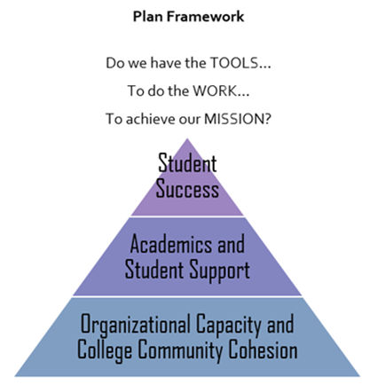
Implementing Our Vision Strategic Plan
Topic Area 2: Academics and Student Support
Goal 2.1:
Implement Guided Pathways in order to ensure student-focused academic programs
Goal 2.1: Implement Guided Pathways in order to ensure student-focused academic programs
Goal 2.3 Improve the effectiveness of campus-wide instructional and student support
Goal 2.4 Increase institutional efficiency of student support through technology, communication and professional development

Slide 5
A Student's Journey
Major Courses + GEs
Degrees + Certificates
Career

Slide 6
The CCC Counseling Department Approach to GE Selection
Factors Counselors Utilize When Making GE Recommendations
Student-Centered interest, focus, needs
Flexibility for Associate Degree and Transfer GE Requirements
Front load GE's for certain majors
Flexibility for major prep at multiple transfer campuses
Career related skills/content/topics
Scheduling
Statewide policies: Ex. CSU Group 1 and 2 Graduation Req

Slide 7
Rubric: GE Criteria (DRAFT)
DRAFT: General Education Course Selection Rubric
RUBRIC SCALE |  | Meets Criteria (YES) Not Sure (?- Meet with CCC Counselor for clarification) Does Not Meet Criteria (NO)
GE CRITERIA
 | Student-Centered Interest, Focus, Needs | Career Related Skills | Career Related Content/ Topics | Associate Degree GE Requirement | CSU GE Require-ment | IGETC GE Require-ment | Flexibility for multiple majors | Flexibility for major prep at multiple transfer campuses | Statewide Policies Example: CSU Group 1 and 2 Graduation Requirement
GE COURSE:
GE COURSE:

Slide 8
Let's Help a Student! The language of college to career
Business Administration student preparing a resume
Manager position at Macy's

Slide 9
Job Posting
Qualifications and competencies:
Effectively communicate and present information in one-on-one and small group situations to customers, and all levels of internal and external business partners.
Ability to effectively plan and execute strategies.
Ability to monitor and maneuver workflow to achieve priorities.
Effective written and verbal skills, ability to interpret instructional documents such as safety rules, operating and maintenance instructions, and procedure manuals.

Slide 10
Career Skills
Information obtained from Onetonline.org
Skills: active listening, reading comprehension, time management, speaking, coordination
Work activities: getting information, communicating with others, organizing, planning and prioritizing work, problem-solving and decision-making

Slide 11
Resume Statement
A resume statement is a brief description or a few sentences at the top of a resume that highlights qualifications for a job. Also known as a “summary of qualifications”, a resume statement gives the hiring manager a synopsis of your professional qualifications.
Work with a student to help highlight skills and key words i.e “effectively communicate”
Emphasize accomplishments based on learned skills
Identify skill sets that would be outside of the typical applicant
EXAMPLE: Multi-faceted, efficient, and reliable administrative professional with 10+ years of experience supporting executives, sales personnel, and managers to improve internal operations for small business operations.

Slide 12
Breakout Rooms
Small Group Discussion:
How will a GE course your program offers (or a GE course you are familiar with) support skills acquisition for a student applying to this management position?
Consider: Course SLOs, objectives, content, activities, etc.
Activity: Help complete the student's resume.

Slide 13
General Education

Slide 14
GE Areas
Associate | CSU | IGETC | Neither
https://www.contracosta.edu/wp-content/uploads/2020/07/Associate-Degree-2020-2021-.pdf | https://www.contracosta.edu/wp-content/uploads/2020/07/CSU-GE-B-2020-2021-.pdf | https://www.contracosta.edu/wp-content/uploads/2020/07/IGETC-2020-2021.pdf | https://assist.org/transfer/report/24665281
Specific to Local CCC GE requirements Some, not all, of CCC GE courses are transferable to CSU/UC Coded as 'DG' | Specific to CSU transfer only Requires Oral Communications Requires Life-Long Learning & Self-Development Coded as 'CSU' | Utilized for students who are applying to both CSU and UC campuses UC does not require CSU specific GE requirements UC requires Foreign Language Coded as 'UC' | Some majors at some transfer campuses require their own GE pattern Discourage or do not accept IGETC Ex. Engineering at UC Berkeley

Slide 15
IGETC Area 3A Courses (Arts)
Music | Music 119- Basic Music Music 114- Pop, Rock, and Jazz: Their Cultural Origins Music 102- Beginning Group Voice: Cultural Perspective Music 104- A History of Singing
Drama | Drama 102- Multicultural Perspectives in American Theatre Drama 103- History of the Theatre: Pre-Greek to 17th Century Drama 126- Script Analysis Drama 165- Chicana/o-Latina/o Theatre
Art | Art 117- Appreciation of Art and Architecture Art 190- Art History: Prehistory to Renaissance Art 191- Art History: Renaissance to Modern

Slide 16
Breakout Rooms
Each group assigned one career:
Medical Assistant (1), Chef (2), Counselor (3), Bioinformatics Scientist (4), Database Administrator (5), Public Relations Specialist (6)
Small Group Discussion:
Of the courses you just heard about, which would be a good choice for this career and why?
What other information may be needed to help a student make their choice?

Slide 17
Medical Assistant
Summary of Position: Perform administrative and certain clinical duties under the direction of a physician.
Skills: Speaking, active listening, reading comprehension, social perceptiveness, monitoring/assessing self or others
Work Activities:
Record vital statistics or other health information.
Assess physical conditions of patients to aid in diagnosis or treatment.
Clean patient rooms or patient treatment rooms.
Interview patients to gather medical information.
Prepare patient treatment areas for use.

Slide 18
Chef
Summary of Position: Plan, direct, and participate in the preparation of foods.
Skills: Monitoring of self and others, coordination, speaking, management of personnel resources, social perceptiveness
Work Activities:
Create new recipes or food presentations.
Estimate supplies, ingredients, or staff requirements for food preparation activities.
Train food preparation or food service personnel.
Coordinate activities of food service staff.
Inspect facilities, food, equipment or supplies to ensure conformance to standards.

Slide 19
Counselor
Summary of Position: Advise and assist students and provide educational and vocational guidance services.
Skills: Active listening, social perceptiveness, speaking, reading comprehension
Work Activities:
Intervene in crisis situations to assist clients.
Collaborate with other professionals to assess client needs or plan treatments.
Confer with family members to discuss client treatment plans or progress.
Counsel clients regarding interpersonal issues.
Evaluate potential problems in home or work environments of clients.

Slide 20
Bioinformatics Scientist
Summary of Position: Conduct research using bioinformatics theory; may design databases and develop algorithms for processing and analyzing biological information.
Skills: Critical thinking, reading comprehension, active listening, complex problem-solving, speaking
Work Activities:
Develop software or applications for scientific or technical use.
Prepare scientific or technical reports or presentations.
Advise others on the development or use of new technologies.
Analyze biological samples.
Review professional literature to maintain professional knowledge.

Slide 21
Database Administrator
Summary of Position: Coordinate the implementation and maintenance of computer databases, applying knowledge of database management systems.
Skills: Critical thinking, complex problem-solving, active learning, active listening, judgement and decision-making
Work Activities:
Assess database performance.
Modify software programs to improve performance.
Implement security measures for computer or information systems.
Develop computer or information security policies or procedures.
Create databases to store electronic data.

Slide 22
Public Relations Specialist
Summary of Position: Promote or create an intended public image for individuals, groups, or organizations.
Skills: active listening, speaking, coordination, social perceptiveness, time management
Work Activities:
Provide educational information to the public.
Write and edit advertising or promotional or informational material.
Develop promotional strategies or plans.
Coach others.
Collaborate with others in marketing activities.

Slide 23
What Next?
Consider: What GE recommendations could be incorporated into your program pathway that will support the acquirement of soft skills?
Fall 2021: Explore additional GE offerings and embed into program pathways and meta-majors.

Slide 24
Break 5 mins

Slide 25
Program Groupings

Slide 26
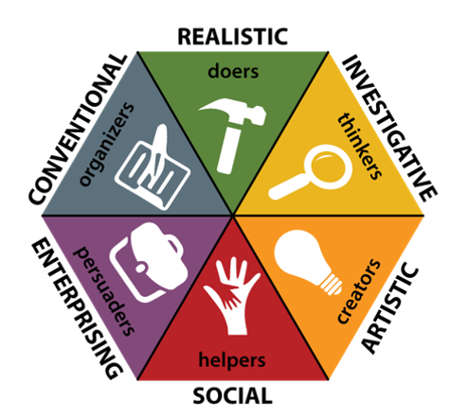
Holland Code
Holland Code
(RIASEC/Interest Code)
John Holland's
Career Choice Theory
6 areas of interest
Notes:
Ask people to name the holland code for the career they just worked with.
Organizing programs by interests is a fairly popular strategy among community college Guided Pathways work. As a recap, for anyone who may not be familiar with the idea – The Holland Code, sometimes called the RIASEC scale or Interest Codes was developed by a career theorist named John Holland. In a nutshell, his Career Choice Theory outlines that our interests fall into 6 different areas. Typically, our interests are grouped into a top three and a bottom three. In all of the years I have been teaching this to students, I would say it is typical for there to be a top three but some students do have a very strong top two. This doesn’t negate the theory but rather allows for flexibility in career exploration. It is important to note with the top/bottom area rankings, it doesn't mean that someone has zero interest in the lower areas. And, as a reminder, this doesn't address skill, just what we like and dislike.
The wheel to the right is a very simplistic image of John Holland's theory – the colors are arbitrary but do help students define the areas more easily. As we walk through the definitions of each area, consider which area you personally are most interested in and jot down what you think your top one or two areas are.
R's or realistic are our "doers". These are people who enjoy hands on work. Given our space and time, instead of asking for shoutouts I'll share a few possible R occupations: Automotive technicians, police officers, carpenters.
I or Investigative I call our "ists": biologist, analyst, chemist, and don't forget our social scientist– these are our folks who like to know how and why things are the way they are.
A or Artist, you might imagine are our creators. People who enjoy self expression and creativity at work. Artists, performers, digital designers, philosophers and culinary artists could all have a high interest area in A.
Social, our helpers are those who enjoy helping others. At CCC some "social" students might be our HHS students, ECHD and our students who we are forming as social justice warriors .
Enterprising talks about those who enjoy persuading others. Our business program may attract these students but also in this area are our politicians, our lawyers and our sales professionals.
And last but not least, our careful organizers otherwise known as Conventional. Conventional types like process and order in their work. Think accountants and perhaps our Medical Assistants.
That's the nutshell of Holland

Slide 27
Holland:
@ CCC:
One career or occupation could attract multiple interests
Should programs be listed in multiple areas (I.e. nursing)
As we mature, our interests evolve
Some interests are supported outside of work
How can we support students in their interest development?
Notes:
But - In addition to the interest areas, there are some other things ideas that Mr. Holland left for us: #1 It's important to note that one job does not fall neatly into one interest area. Medical Assisting for example – I just used that occupation as an example as Conventional, which it is. But it is also a helping career, which is S or Social. We could have two students graduate from that program at CCC, each with different leading interest areas. So as we continue this work at Contra Costa College, we have to think about how we want to group our programs – one program per area or would it actually serve students to have some of our programs listed in multiple areas, as John Holland's theory of career choice suggests. Two other points he made were that as we mature, our interests evolve and grow and for many people, our top interest area isn't always met by work – sometimes it's fulfilled through other activities such as hobbies. So, we will also have to consider if and how we can support our students in their interest development while at CCC.

Slide 28
CCC Programs by Holland Code -
Health and Wellness Allied Health (Certified Nurse Assistant, Clinical Medical Assistant, Pre-Allied Health, Registered Nursing) Biotechnology Emergency Medical Services Health Education and Sciences (HED, Kinesiology, Public Health) Health and Human Services Nursing |  | STEM Biology Biotechnology Chemistry Computer Science | Engineering Mathematics LA: Math and Science Physics | Visual, Performing, and Culinary Arts Art: (painting, drawing, visual & performing) Culinary Arts Drama – performance | Music LA: Arts and Humanities
People, Culture, and Social Sciences Admin of Justice African American Studies Anthropology Early Childhood Education Earth Science Geography | History Humanities La Raza Studies Philosophy Political Science Psychology Sociology LA: Arts and Humanities | Business and Communications Accounting Business Business Office Technology Communication Studies (Communication, Journalism, Speech) Economics English ESL Spanish LA: Communication in English Language |  | Applied Technology Automotive Biotechnology Business Office Technology Computer Information Systems

Slide 29
Survey Says!
After reviewing the Guided Pathways Workgroup Videos.
72% of respondents would like to see majors grouped by Holland Code
19% said by Skills and/or Holland combination
87% of respondents think specific GE courses in pathways are extremely or somewhat important
Acc

Slide 30
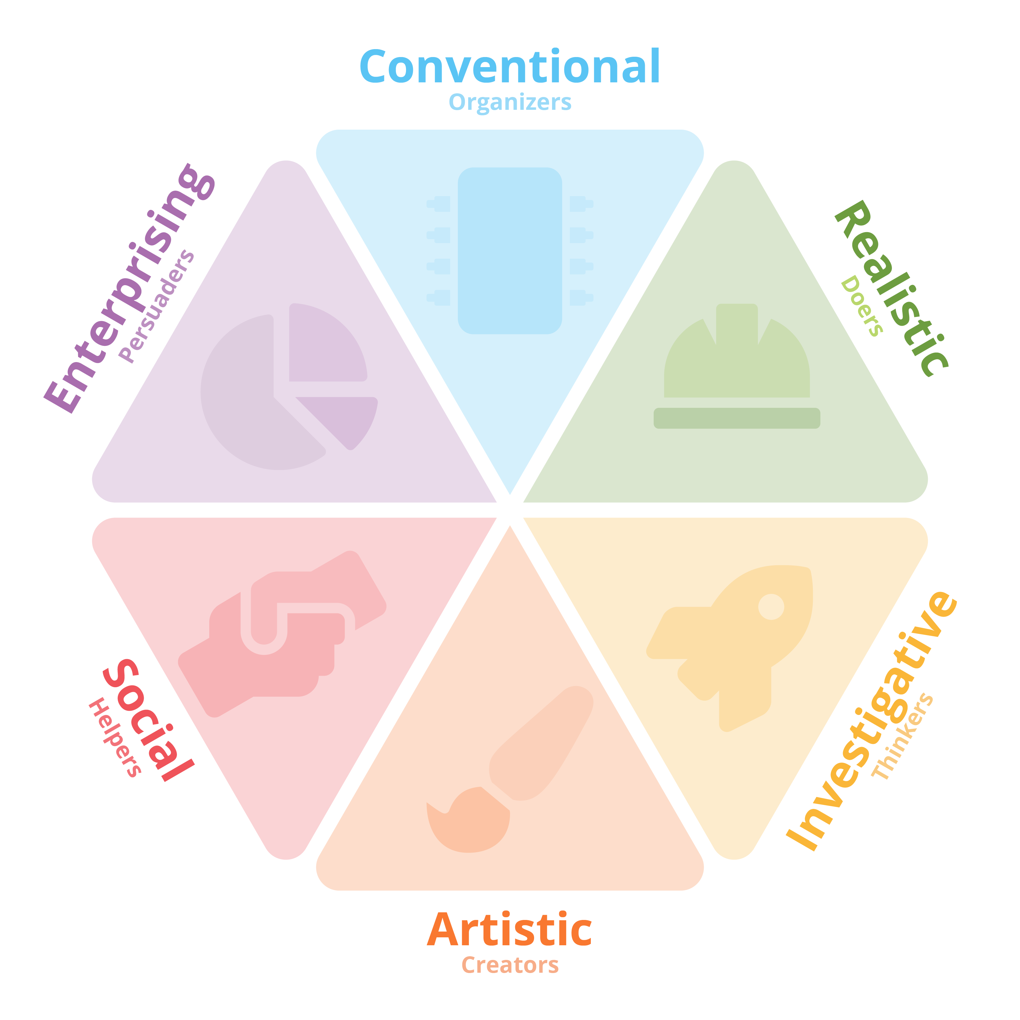
Holland Code
Holland Code
(RIASEC/Interest Code)
John Holland’s Career Choice Theory
6 Areas of Interest

Slide 31
CCC's "Academic & Career Pathway" Formation
Academic and Career
Pathways

Slide 32
Contra Costa College Programs by Holland Code
People, Culture and Social Sciences
Admin of Justice
African American Studies
Anthropology
Early Childhood Education
Earth Sciences
Geography
History
La Raza Studies
Philosophy
Psychology
Sociology
LA: Arts and Humanities
Health and Wellness
Allied Health
Biotechnology
Emergency Medical Services
Health Education and Sciences
Health and Human Services
Nursing
Business and Communications
Accounting
Business
Business Office Technology
Communication Studies
Economics
English
ESL
Spanish
LA: Communication in English Language
Science, Technology, Engineering and Math
Biology
Biotechnology
Chemistry
Computer Sciences
Engineering
Mathematics
LA: Math and Science
Physics
Applied Technology
Automotive
Biotechnology
Business Office Technology
Computer Information Systems
Visual, Performing and Culinary Arts
Art: Painting, Drawing, Visual & Performing
Culinary Arts
Drama: Performance
Music
Feedback 4/14 - Today:
Create Language and Communications Group
LA: in Behavioral Sciences is missing
Add Fine Arts to Visual, Performing, and Culinary Arts
Student Feedback is needed
Remove Earth Science
Support foundational concepts and connections to career
Notes:
Not speaking about layout or formatting/colors, etc, direct team to focus on groupings, which are based on Holland Interests, Career Skill and Curriculum.
Culinary arts at CCC falls into Arts bc that is the current focus of the curriculum.
Option 1: As is
Option 2: Split Business out and rename "Languages and Communication"
Option 3: Combine with Visual/Performing/Culinary Arts with a rename...

Slide 33
Health and Wellness
Allied Health (Certified Nurse Assistant, Clinical Medical Assistant, Pre-Allied Health, Registered Nursing)
Biotechnology
Emergency Medical Services (Emergency Medical Technician, Paramedic)
Health Education & Sciences (HED, Kinesiology, Public Health)
Health & Human Services

Slide 34
STEM
Biological Sciences (Biology, Biotechnology)
Chemistry
Computer Science
Engineering
Liberal Arts: Math & Science, STEM
Math
Physics

Slide 35
Next Steps
May
Present to College Council & NSAS
Incorporate feedback into Pathway groupings
Share pathways with students
Plan
Marketing and Communication plan for 2022-2023 debut
October
Incorporate student feedback & Constituent Endorsement
June - July
August – September

Slide 36
2021-2022 Goals
Finalize and Endorsement of “Academic and Career Pathways” Develop and communicate Student Support and Success Teams Develop contextualized learning experiences for Academic and Career Pathways Create Guided Pathways marketing campaign to begin Late Spring 2022

Slide 37
Thank You
Guided Pathways Tri-Chairs
Demetria Lawrence
Sarah Boland
Steering Committee
Rod Santos Nooshi Borhan Kate Weinstein
Leslie Alexander Lorena Gonzalez Kelly Ramos
Rene Sporer
Dennis Franco Marisol Cantu Shelley Ruby
Natasha DeAlmeida

